Slide 1



Assignment 1: Selfies
By Danica Yong z5142161
View in Power BI
Last data refresh:
3/24/2019 12:32:00 AM AUS Eastern Standard Time
Downloaded at:
3/27/2019 8:56:38 PM AUS Eastern Standard Time

Slide 2
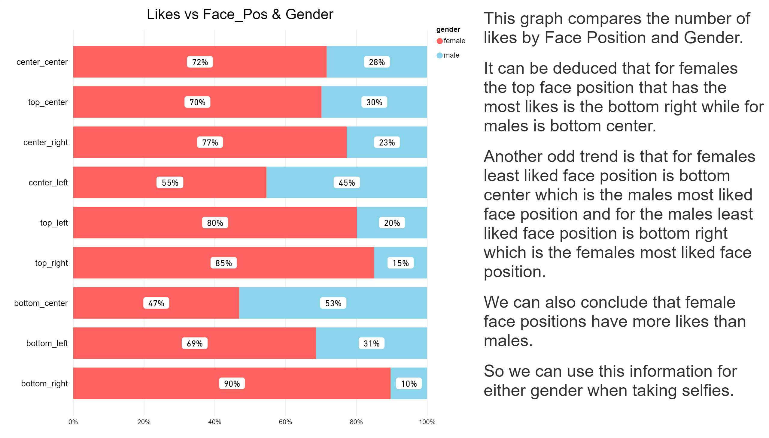

Slide 3
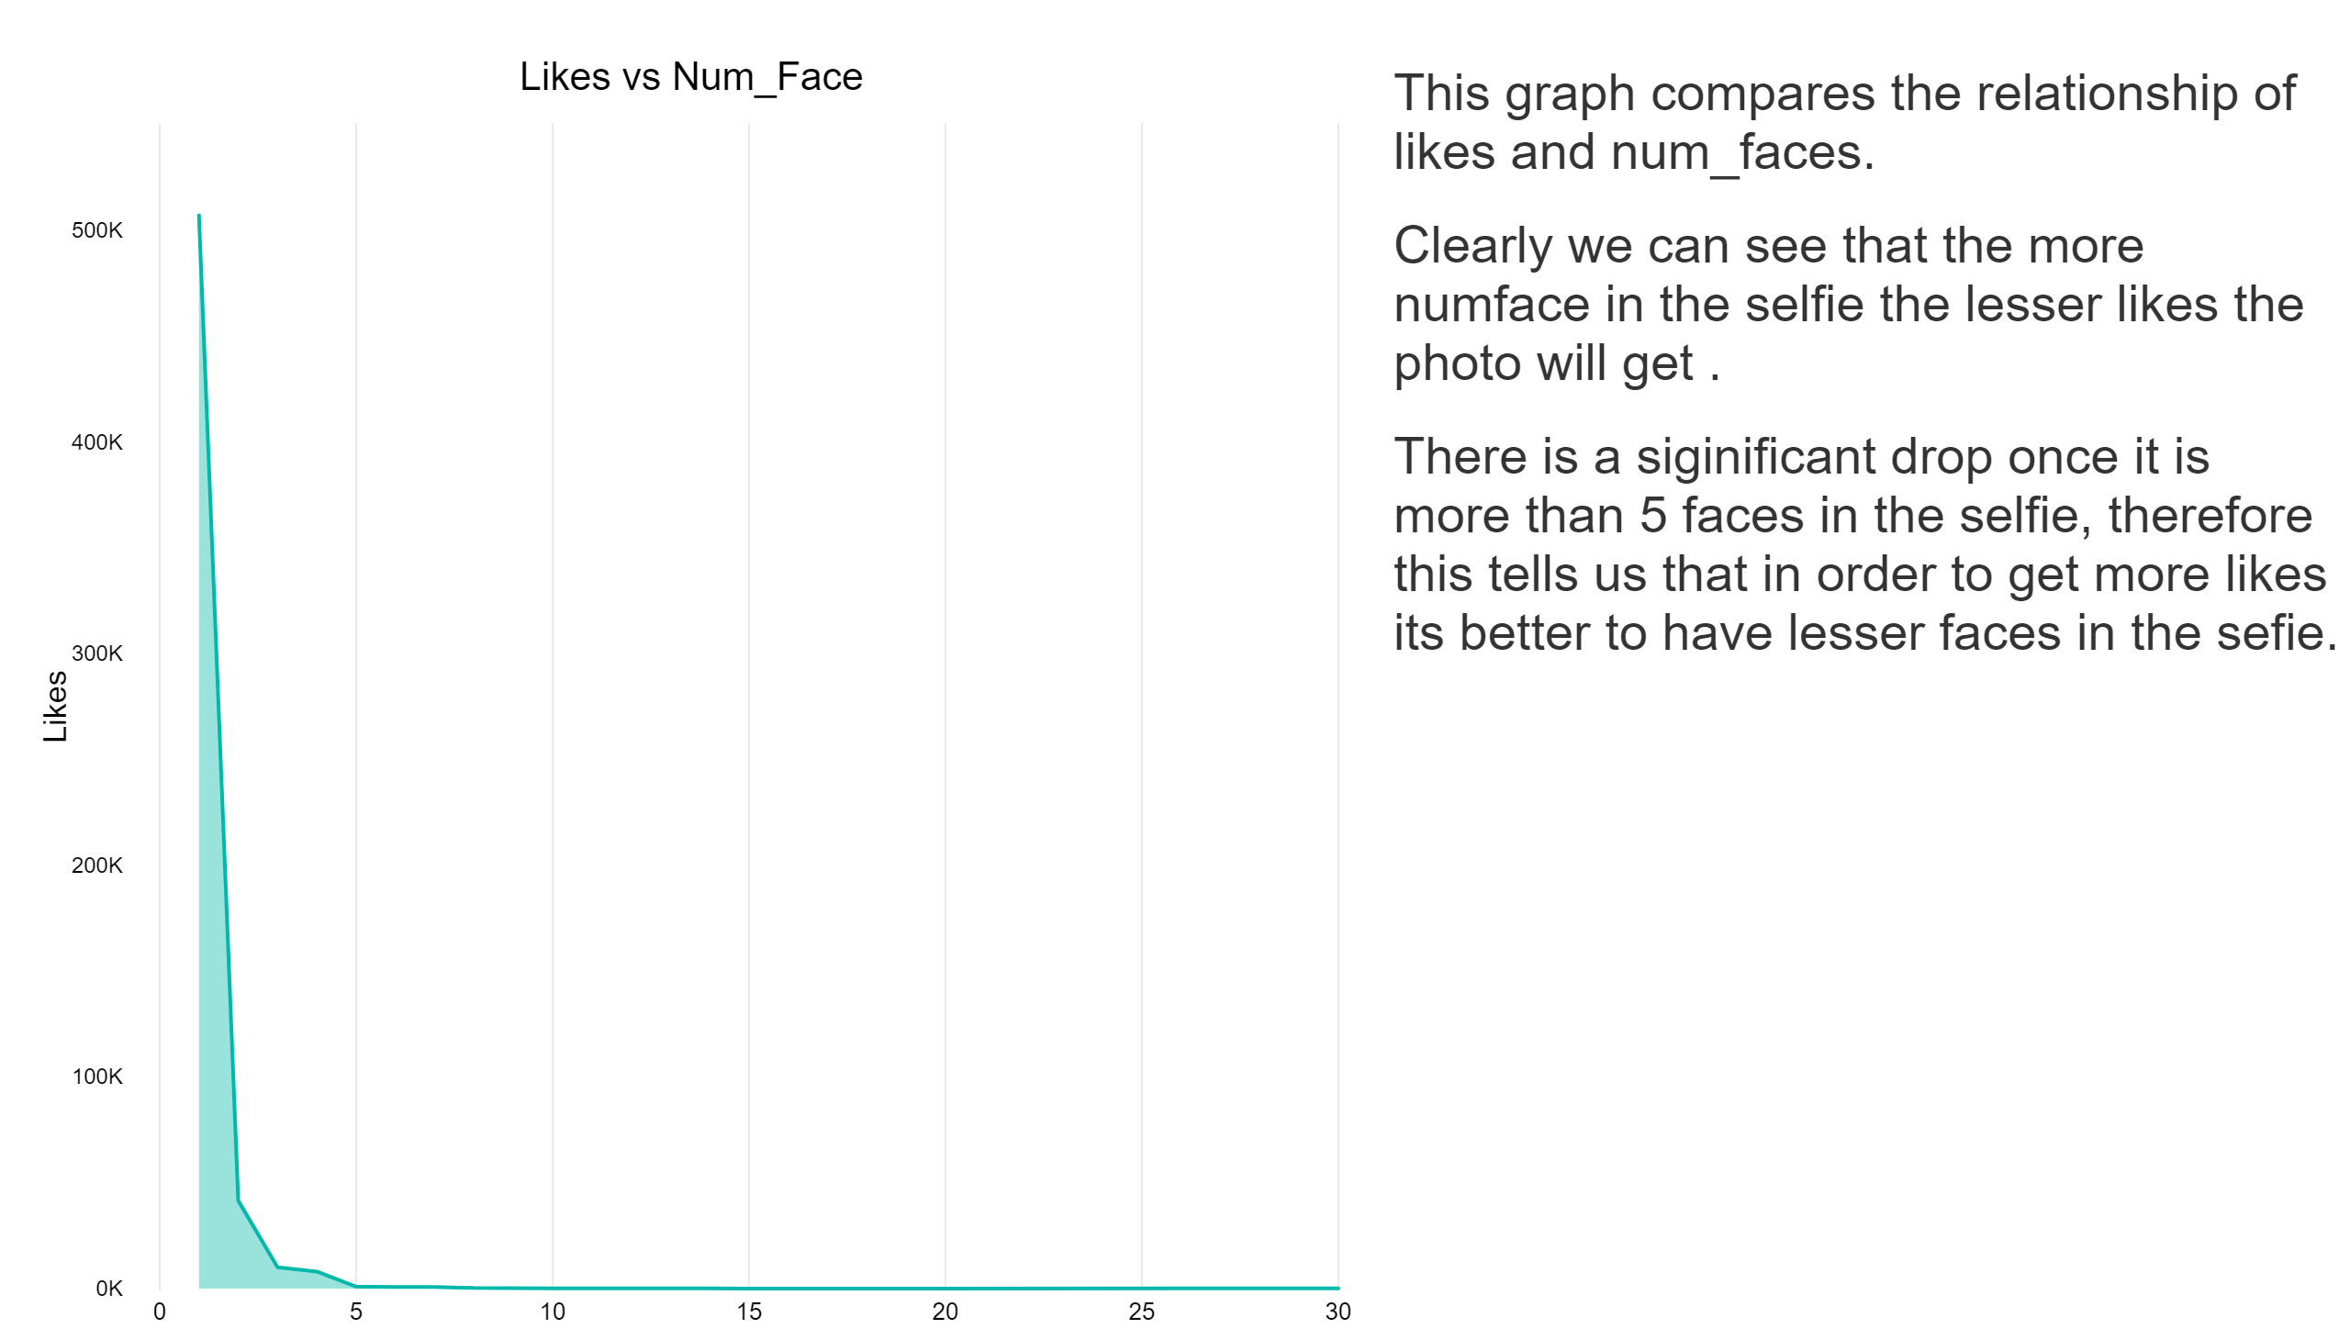

Slide 4
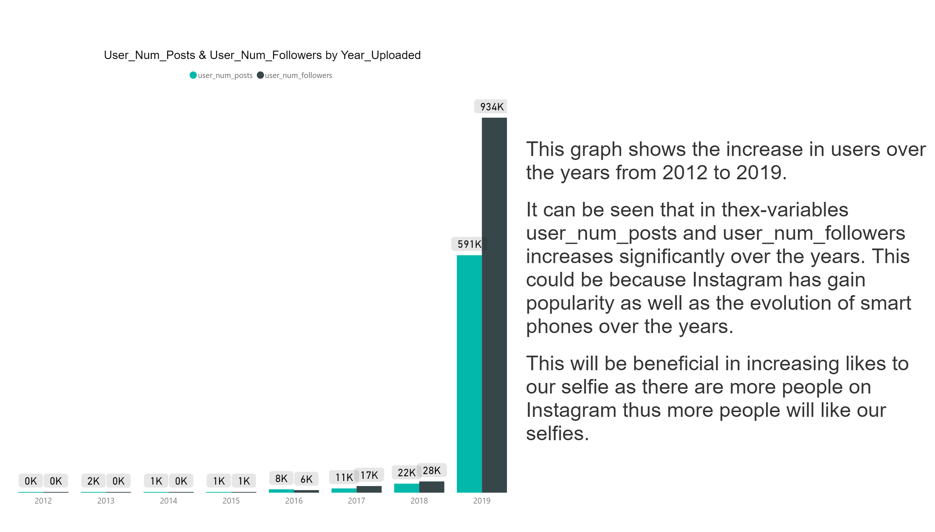

Slide 5
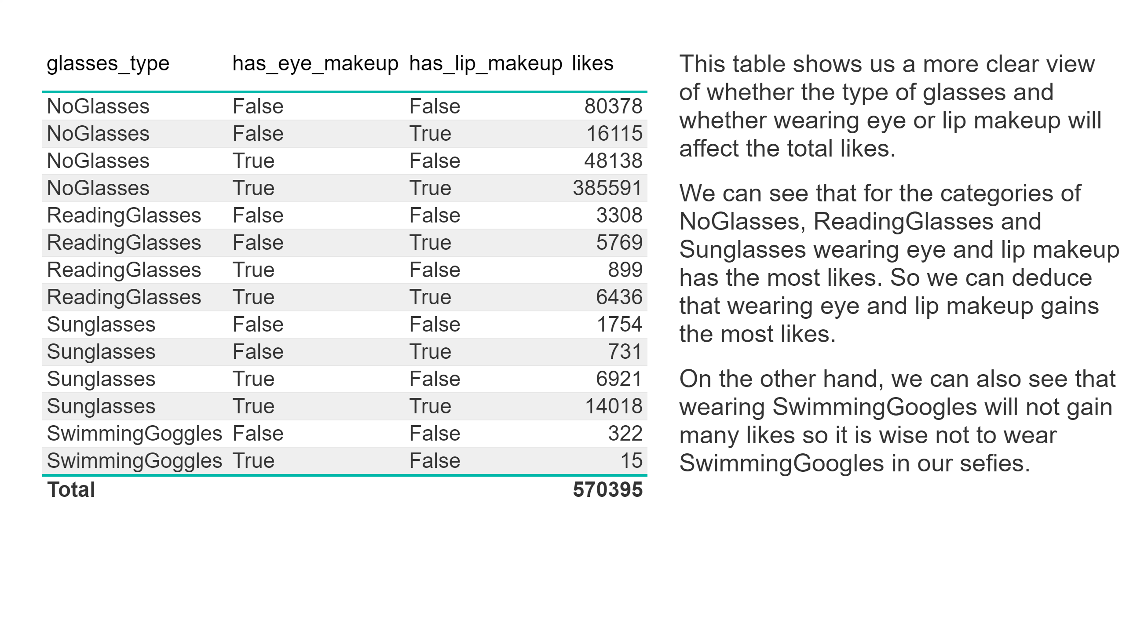

Slide 6
